Slide 1
Introduction to chatbots

Slide 2
Unit objectives
Explain what a chatbot is.
Describe the common applications of chatbots.
Identify factors that drive the growing popularity of chatbots.
Recognize the guidelines to consider when designing a chatbot .
List examples of tools and services that you can use to create chatbots.

Slide 3
Topics
Chatbots overview
Chatbots design
Chatbots tools and services

Slide 4
Chatbots overview

Slide 5
What is a chatbot
Software that interacts with the user in natural language.
The application can have a chat interface.
The conversation medium may be in text, speech, or both.
Some example applications are customer support, sales activities, or entertainment.
Notes:
A chatbot is software that interacts with the user through a chat interface by using natural language. The conversation might be in text, speech, or both. The chatbot chats with the user to assist with applications like customer support, sales activities, or entertainment.

Slide 6
Chatbots in the industry
Apple Siri, Microsoft Cortana, Google Assistant, and Amazon Alexa:
Interact by using natural language and often in the form of speech.
Support functions like setting alarms, running searches, and retrieving real-time information like news.
Notes:
There are many examples of chatbots:
Siri: The intelligent assistant of Apple iPhone. Siri can help you with your schedule and find the nearest restaurant or movies that are available to watch.
Microsoft Cortana: Supported on various Microsoft Windows platforms. Also supported on Android and iOS. It can set reminders and answer questions by using information from the Bing search engine.
Google Assistant: Available on mobile and smart home devices. It provides the same functions that Google does: Searches the internet, schedules events and alarms, adjusts hardware settings on the user's device, and shows information from the user's Google account.
Amazon Alexa: Plays music and audiobooks, supports to-do lists, sets alarms, provides news and other real-time information like weather updates, traffic, and sports. Alexa can also control different smart devices that are part of a home automation system. You can give voice commands to control your home automation system like “Alexa, turn off the light in the living room.”.
References:
Google Assistant
https://en.wikipedia.org/wiki/Google_Assistant
Cortana
https://en.wikipedia.org/wiki/Cortana
Amazon Alexa
https://en.wikipedia.org/wiki/Amazon_Alexa

Slide 7

Chatbots in the industry (cont.)
IBM Watson Assistant is tailored for domain-specific use cases.
Notes:
Another example of a chatbot is one that supports customers with their inquiries or even helps junior customer support agents with their job. IBM uses Watson technology (Watson Assistant) to create chatbots for those purposes.

Slide 8
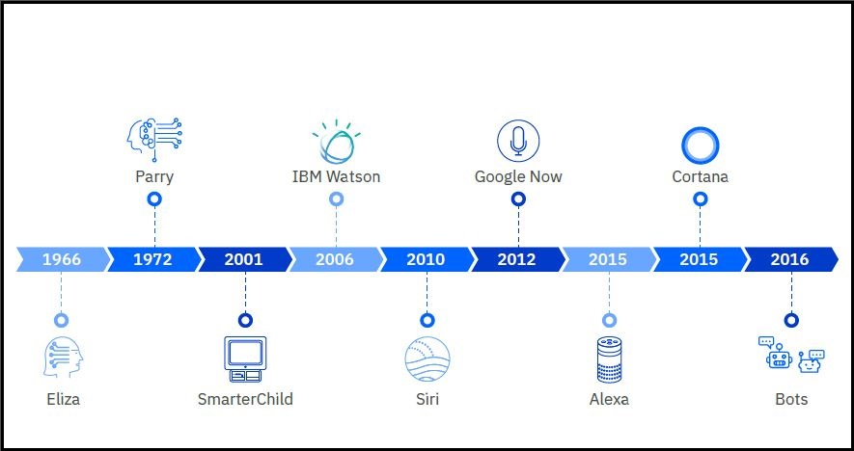
Chatbot history
Bots passing the Turing test.
ELIZA and PARRY did not use speech.
SmarterChild was the predecessor to Siri, and was created by ActiveBuddy, Inc.
Notes:
1950s: The Turing test
The Turing test by Alan Turing was introduced as a standard of intelligence.
The standard is based on the capability of the computer program to impersonate or mimic a human in real time through a written conversation with a human judge. If the judge cannot distinguish between the program and a real human based on the conversation alone, the program passes the Turing test. Many programmers took the Turing test as a challenge.
1966: ELIZA In 1966, Metzenbaum’s program ELIZA tricked users into believing that they were having a conversation with a human. ELIZA passed the Turing test.
1972: PARRY
Another chatbot was invented around 1972 that was called PARRY. PARRY was more advanced than ELIZA. However, both ELIZA and PARRY could have a conversation only through text (not speech). Advances in natural language processing have led to the emergence of more capable chatbots since then.
2001: SmarterChild
In 2001, SmarterChild emerged. It was a chatbot that was used across SMS networks. It took advantage of the popularity of SMS and added the capability to understand natural language. It relied on database access for news, sports, entertainment, and other various topics. It is considered the precursor to Siri.
2006: IBM Watson In 2006, IBM Watson started initial test runs. In 2011, Watson competed on the Jeopardy! quiz TV show. It understood and answered trivia questions, and won against human contestants (the Jeopardy! champions).
2010: Siri
Siri emerged in 2010 as a personal assistant feature of Apple iOS. Siri can search for answers on the web, create reminders, alarms, and events, call people, and much more. 2012: Google Now
In 2012, Google Now emerged, appearing as a feature in Google search. It delivered information to users based on predictions of what they might be interested in knowing.
2015: Amazon Alexa and Microsoft Cortana
In 2015, Amazon Alexa, the virtual assistant behind Amazon Echo, and Microsoft Cortana emerged.
2016: Chatbots
Facebook started a messaging platform enabling developers to create chatbots that can interact with Facebook users. Today, there are more than 33,000 chatbots on Facebook Messenger alone.

Slide 9
Why now
Rising popularity and high usage of messenger applications, such as WhatsApp, Facebook Messenger, and Slack
Recent breakthroughs in the AI field
Advancements in speech recognition
Growing popularity of cloud computing and APIs
Notes:
It seems that chatbots have become popular in recent years. Why now?
There are different reasons for the increase in the prevalence of chatbot:
Rising popularity and high usage of messenger applications, such as WhatsApp, Facebook Messenger, and Slack.
Recent breakthroughs in the AI field make it possible to develop intelligent chatbots that can communicate with users in human language and learn from their interaction with users. Chatbots can learn over time to provide more accurate and intelligent responses.
Advancements in speech recognition make it possible to take human speech as input and enable users to have more natural interaction with computers.
The growing popularity of cloud computing and APIs that provide integration capabilities make it possible for AI vendors to make AI services easily available to developers on the cloud. Developers can integrate chatbots into various applications and ensure reliable communication between the chatbot and the application by using APIs.

Slide 10
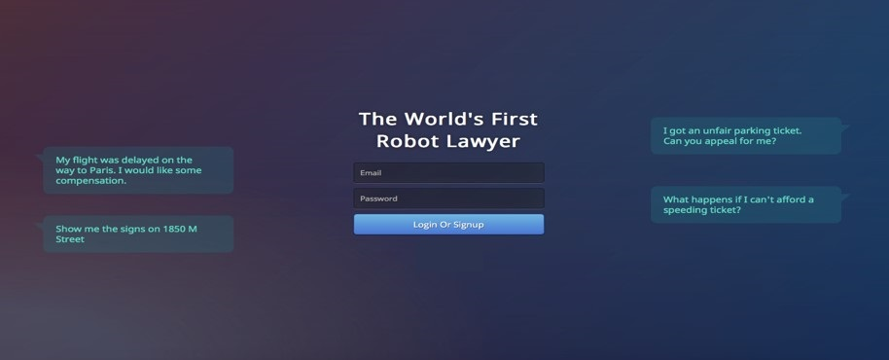
Popular chatbots
DoNotPay chatbot for legal advice by Joshua Browder.
Joshua Browder was named “Robin Hood of the internet” by the BBC.
He used the IBM Watson Assistant service to improve the chatbot’s accuracy by 30%.
Notes:
The DoNotPay chatbot is a popular chatbot. It was created by a 19-year old Stanford student who is named Joshua Browder, whom is called “Robin Hood of the internet” by the BBC.
Browder used a natural language interface to gather the data that is needed to complete the form. He also used the IBM Watson Assistant service to improve that chatbot’s accuracy by 30%.

Slide 11
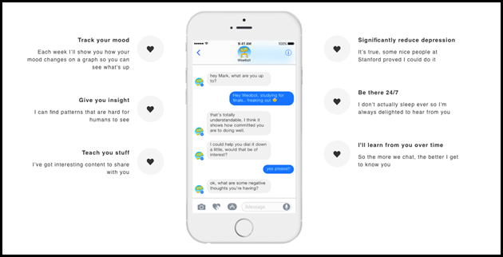
Popular chatbots (cont.)
Woebot in the medical domain.
“Create the experience of a therapeutic conversation for all of the people that use the bot.”
Notes:
Woebot was created by a team of Stanford psychologists and AI experts.
Woebot uses short chat conversations, sentiment and tone analysis, and word games to help people who are looking for inexpensive therapy. The mission of the creators of Woebot is “to make mental health radically accessible to everyone”.
Woebot uses a combination of natural language processing, therapeutic expertise, personalized content, and a sense of humor to “create the experience of a therapeutic conversation for all of the people that use the bot.”

Slide 12
Chatbots design

Slide 13
Chatbot design
The basic goals of conversational interaction for chatbots are:
Help users.
Manage user expectations.
Achieve the purpose of the solution.
Keep the user engaged.
Extract insights about the users.
Reinforce the brand of the client.
Increase sympathy and forgiveness in users.
Make the solution look clever.
Notes:
Conversational interaction in the chat between the chatbot and the user takes place by exchanging natural language messages. Conversational interaction has an important role to play because it must help the customer understand how the chatbot can help them while managing expectations.
It is important to design the conversation correctly and appropriately for the type of chatbot solution and target audience. Not all solutions need the same amount of conversational interaction, but if you do not deliberately design the conversational interaction, you will not fully realize the potential of the solution to address the needs of your clients. If clients do not see enough value from the chatbot solution, they are unlikely to continue to use it.
The basic goals of conversational interaction are:
How to help users and manage their expectations.
Help achieve the purpose of the solution and drive value.
Encourage the user to keep using the chatbot.
Derive usable insights about the users.
Reinforce the brand of the client.
Increase sympathy and forgiveness in users.
Make the solution look clever.
To achieve these goals, the dialog must be carefully designed to use the appropriate language and a suitable approach. Designing the chatbot is the part that is most removed from development. The result of this design is the overall impression of the chatbot on the user.
Here are key factors to consider in the conversational design:
Positioning
Tone and personality

Slide 14
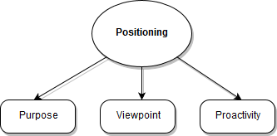
Chatbot design: Positioning
Positioning
The positioning of the chatbot is a collective term that covers these three aspects:
Purpose
Viewpoint
Proactivity
Notes:
To achieve your chatbot design goals, you must define different aspects about how to design your chatbot .
The first concept to consider is positioning. Positioning determines how the solution should relate to the user, and behave when interacting with the user. The positioning of the chatbot is a collective term that covers these three aspects:
Purpose
Viewpoint
Proactivity

Slide 15
Chatbot design: Positioning (cont.)
Purpose: What is the purpose of the solution?
Examples:
Clarify or answer the user’s questions.
Guide users to find the information they are looking for.
Help users to complete a process.
Collect the information that is needed to report a problem.
Notes:
Purpose: What is the purpose of the solution?
A conversational interaction should always have a clear purpose, that is, a well-defined job to do. For example:
Clarify or answer the user’s questions.
Guide users to find the information they are looking for.
Help users to complete a process.
Collect the information that is needed to report a problem.
The purpose is the “job description” of the chatbot.
Chatbots, unlike standard application UI, tend to humanize interactions and they should be tailored to the needs of the users.

Slide 16
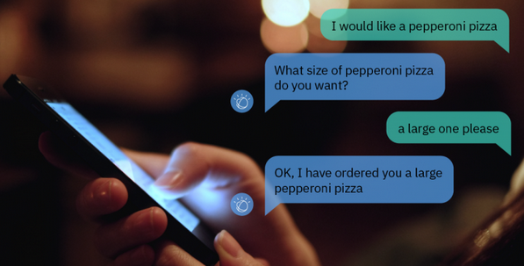
Chatbot design: Positioning (cont.)
Viewpoint: What role should the solution play in the relationship between the client and the user?
Examples: Assistant, friend, coach, motivator, salesperson, and others
Notes:
Viewpoint:
Viewpoint is the role that the chatbot solution should adopt in relation to the end user. As a designer, ask yourself:
Who is the audience? (for example, students, prospect clients, users of your product, tourists, and so on)
Who does the chatbot speak on behalf of? (for example, an employee who speaks on behalf of the company, as an advocate or friend to the user who speaks on behalf of the tourism organization, a tutor or teacher who speaks on behalf of a school or university, and so on.)
The relationship that the bot will have with the user should be decided upon in light of achieving the purpose previously determined: Does the chatbot represent a salesperson? an entertainer? a teacher? an enforcer or regulator? a companion or friend?
Viewpoint can be determined through these questions:
What role should the solution play in the relationship between the client and the user?
Should the chatbot present itself as an employee who speaks on behalf of the client and is aligned with the client interests?
Should the chatbot present itself as an advocate or friend to the user who can access the client’s information to help the user?
Some examples of roles or viewpoint are:
Assistant
Friend
Coach
Motivator
Salesperson
Another question is, who is the audience? Are they students, prospect clients, users of a product, or others?

Slide 17
Chatbot design: Positioning (cont.)
Proactivity:
Level of proactiveness or reactiveness when engaging with user.
A chatbot can be:
Proactive (lean forward): The chatbot reaches out to the user and asks questions.
Reactive (lean backward): The chatbot waits for the user to ask a question.
Combination: The chatbot uses both techniques.
Notes:
Proactivity is the degree to which the solution proactively engages and guides the user instead of reacting to the user, that is, waiting for the user to ask a question.
A chatbot can be:
Proactive: The chatbot reaches out to the user by asking questions, offering information and choices, and guiding the user through processes.
Reactive: Apart from a welcome message (and perhaps one or two other statements), your chatbot waits for the user to ask a question. It does not prompt, encourage, or suggest.
Combination: In specific circumstances, the chatbot reaches out to the user, asking questions and guiding the user through processes. At other times, the chatbot waits for the user to ask a question.

Slide 18
Chatbot design: Positioning (cont.)
Example of a proactive chatbot:
Customer: When can I receive my new credit card?
Chatbot: An SMS will be sent to your phone after it is ready.
Chatbot: The bank is collaborating with XYZ to provide benefits to our credit card users. Would you be interested in knowing more?
Notes:
Imagine a scenario where a chatbot is acting as a customer service employee on behalf of a bank.
The following conversation represents a proactive chatbot:
Customer: When can I receive my new credit card?
Chatbot: An SMS will be sent to your phone after it is ready.
Chatbot: The bank is collaborating with XYZ to provide benefits to our credit card users. Would you be interested in knowing more?
The chatbot answers when asked, but also reaches out to the customer and offers suitable suggestions.

Slide 19
Chatbot design: Positioning (cont.)
Example of a reactive chatbot:
Customer: When can I receive my new credit card?
Chatbot: An SMS will be sent to your phone after it is ready.
Notes:
The following conversation represents a reactive chatbot:
Customer: When can I receive my new credit card?
Chatbot: An SMS will be sent to your phone after it is ready.
The chatbot waits for the customer’s question, and answers only when asked.

Slide 20
Chatbot design: Tone and personality
Represents the voice in which the chatbot solution speaks.
Examples:
Informal and friendly tone: “Hi there, how can I help you?”
More formal, still friendly: “Good morning. How may I help you today?
Formal, not very friendly: “This is a service that is designed to answer your questions. How may I assist you with your inquiries?”
Notes:
Tone and personality: Represents the voice in which the chatbot solution speaks. Do not confuse tone and personality with viewpoint, which is whom the chatbot speaks on behalf.
Examples:
Informal and friendly tone: “Hi there, how can I help you?”
More formal, still friendly: “Good morning. How may I help you today?”
Formal, not very friendly: “This is a service that is designed to answer your questions. How may I assist you?”

Slide 21
Chatbot design: Tone and personality (cont.)
What happens if you do not define tone and personality?
The chatbot will still have them, but it likely will be incoherent, which leads to a random user experience.
Notes:
What happens if you do not define tone and personality?
All verbal expression has a tone, all conversation is held between two sides, with someone, or something with a personality in mind.
If you do not define tone and personality, the chatbot will still have them, but if they are not deliberately and explicitly determined the chatbot likely will be incoherent, which leads to a random user experience.

Slide 22
Chatbot design: Tone and personality (cont.)
You can construct a complete character persona for your chatbot .
A common feature that is often in chatbots is humor.
Humor increases the user's understanding, forgiveness, and satisfaction.
Notes:
You should determine the kind of personality that your users like better or feel more comfortable interacting with when designing your chatbot.
Personality is affected by the choice of words for the chatbot’s responses.
You can construct a complete character persona for your chatbot.
A common feature that is often in chatbots is humor. Humor can increase the user's understanding and forgiveness when your chatbot cannot understand something. It might even delight the user and increase their satisfaction with the chatbot.

Slide 23
Chatbot design: Tone and personality for purpose
Example 1: If the purpose is to engage users proactively and encourage them to act, a friendly, informal tone will be more successful than a formal or authoritative tone.
Example 2: If the purpose is to provide information or guidance about a serious topic, a casual, chatty tone might undermine the credibility of the information that is provided.
Notes:
Here are two examples of tone and personality for the purpose:
If the purpose is to engage users proactively and encourage them to act, a friendly, informal tone will be more successful than a formal or authoritative tone.
If the purpose is to provide information or guidance about a serious topic, a casual, chatty tone might undermine the credibility of the information that is provided.

Slide 24
Chatbot design: Tone and personality for viewpoint
Example 1: If the viewpoint is that of an employee, the tone and personality should closely reflect the client’s ideal staff member.
Example 2: If the viewpoint is that of a partially or fully independent advocate or guide for the user, then the tone and personality should not be that of enforcer or authority figure. Instead, it should be more like an advisor, assistant, or coach.
Notes:
Here are some examples for tone and personality for viewpoint:
If the viewpoint is that of an employee, the tone and personality should closely reflect the client’s ideal staff member.
If the viewpoint is that of a partially or fully independent advocate or guide for the user, then the tone and personality should not be that of enforcer or authority figure. Instead, it should be more like an advisor, assistant, or coach.

Slide 25
Chatbot design: Tone and personality for proactivity
If the solution is highly proactive, either an overly formal or overly casual and chatty tone may have an unpleasant effect because the former might feel artificial and the latter is likely to become annoying.
Tone and personality for special cases: If a response uses offensive language:
The chatbot can shift to an “enforcer” viewpoint and adopt a more formal tone.
You may keep a count of the number of sensitive inputs and respond with an increasingly strong-worded response.
You may shut down the chat (in the case of threats and offensive language).
Notes:
If the solution is highly proactive, either an overly formal or overly casual and chatty tone may cause a negative reaction because the former might feel artificial and the latter is likely to become annoying.
Consider the appropriate tone and personality for special cases. There might be special cases where the tone response might differ from the rest of the solution. For example, if there are responses that use offensive language:
The chatbot can shift to an “enforcer” viewpoint and adopt a more formal tone.
You may keep a count of the number of sensitive inputs and respond with an increasingly strong-worded response.
You may shut down the chat (in the case of threats and offensive language).

Slide 26
Chatbot design: Design issues
Understand the limitations of a chatbot.
Acknowledge limitations and do not be afraid to have the chatbot say, “I don’t know”, and give some suggestions of questions that they can ask.
Handle frustration. “I can see this isn’t going very well. Would you like to talk to a real person?”
Notes:
Some of the issues that developers or designers face while designing chatbots include the following ones:
Trying to do too much within a single chatbot, which can lead to a loss of value: You must understand the limitations of a chatbot. It must have a narrow scope that is well-defined and well-bounded. It is not a chitchat.
Users will be disappointed by incorrect or nonsensical responses: To avoid this issue, acknowledge limitations and do not be afraid to have the chatbot say, “I don’t know”, and give some suggestions of questions that they can ask.
Detect frustration, and handle it: If the users are frustrated, this issue should be addressed. A good example response can be: “I can see that this isn’t going very well. Would you like to talk to a real person?” Some interactions are too complex for a software solution to handle. Detecting situations that are out of the scope of your chatbot and handing them off to a human quickly (before you waste the user’s time) is a better approach.

Slide 27
Chatbots tools and services

Slide 28
Chatbots tools and services
Here are examples of some available tools and services:
IBM Watson Assistant
Dialogflow
Microsoft Language Understanding Intelligent Service (LUIS)
ChatScript
Chatfuel
Notes:
You can create chatbots by using cognitive services to help you design how your chatbot understands user’s input and replies to the user. You can also use software to configure a chatbot that is already trained and programmed to answer specific questions from users in areas such as customer support.
Here are examples of some available tools and services:
IBM Watson Assistant.
Dialogflow: Google-owned developer of human-computer interaction technologies that are based on natural language conversations.
Microsoft Language Understanding Intelligent Service (LUIS).
ChatScript: Written in C++.
Chatfuel: A platform for creating AI chatbots for Facebook.
References:
chatfuel
https://chatfuel.com/
ChatScript
https://en.wikipedia.org/wiki/ChatScript
Dialogflow
https://dialogflow.com/
Dialogflow
https://en.wikipedia.org/wiki/Dialogflow
Language Understanding (LUIS)
https://www.luis.ai/

Slide 29
Unit summary
Explain what a chatbot is.
Describe the common applications of chatbots.
Identify factors that drive the growing popularity of chatbots.
Recognize the guidelines to consider when designing a chatbot .
List examples of tools and services that you can use to create chatbots.

Slide 30

Review questions
True or False: If a chatbot provides information or guidance about a serious topic, then using a casual, chatty tone is a recommended.
True or False: Advancements in NLP and AI are key factors in the emergence of chatbots.
True or False: A chatbot that reaches out to the user by asking questions and offering information is considered reactive by design.
True or False: There are two types of viewpoint: lean forward and lean backward.
True or False: Chatbots reaching out to the user by asking questions are considered lean forward chatbots.
Notes:
False.
True.
False.
False.
True

Slide 31
Review questions (cont.)
Represents the voice in which the chatbot solution speaks, for example, informal, friendly, or formal.
Viewpoint
Purpose
Tone and personality
Positioning
Proactivity
Notes:
C. Tone and personality.

Slide 32

Review answers
True or False: If a chatbot provides information or guidance about a serious topic, then using a casual, chatty tone is a recommended.
True or False: Advancements in NLP and AI are key factors in the emergence of chatbots.
True or False: A chatbot that reaches out to the user by asking questions and offering information is considered reactive by design.
True or False: There are two types of viewpoint: lean forward and lean backward. False: There are two types of proactivity: lean forward and lean backward.
True or False: Chatbots reaching out to the user by asking questions are considered lean forward chatbots.
Notes:
False.
True.
False.
False. There are two types of proactivity: lean forward and lean backward.
True.

Slide 33
Review answers (cont.)
Represents the voice in which the chatbot solution speaks, for example, informal, friendly, or formal.
Viewpoint
Purpose
Tone and personality
Positioning
Proactivity
Notes:
C. Tone and personality.

